Slide 1
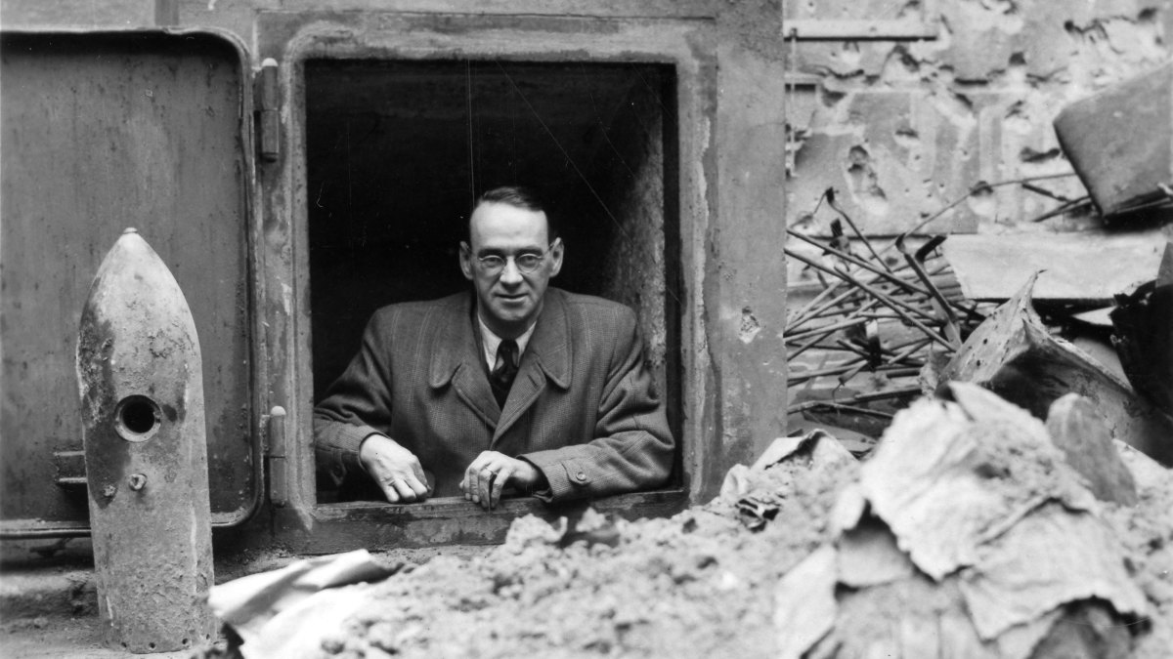
History Heroes
Credited with saving half of Budapest’s Jewish population from the Holocaust, Carl Lutz used paper, not weapons, to fight the Nazis. He even issued official Swiss protection to safe houses throughout Budapest. And, as thousands of Jews were forced to walk to various concentration camps in Austria and Germany, Lutz, with his wife, pulled as many people as they could from the grim march and issued them protective documents.
Week 8

Slide 2
1. How are marks awarded for this question?
Explain the historical context of Source 1. Include the relevant events, people and ideas depicted or represented in the source.
(4 marks)

Slide 3
2. How are marks awarded for this question?
Compare and contrast the purpose of Sources 1 and 2. (5 marks)

Slide 4
3. How are marks awarded for this question?
Explain the message of Source 3. (3 marks)

Slide 5
4. How are marks awarded for this question?
Identify how, and discuss why, Sources 3 and 4 are contestable. (6 marks)

Slide 6
5. How are marks awarded for this question?
Using your knowledge of the whole period of study, evaluate the importance of the themes, ideas and/or events represented in the four sources. (7 marks)

Slide 7
6. What is Anschluss?

Slide 8
7. What was the Soviet-Germany Non-Aggression pact?

Slide 9
8. What was the Munich Pact?

Slide 10
9. What is appeasement?

Slide 11
10. What is Blitzkrieg?

Slide 12
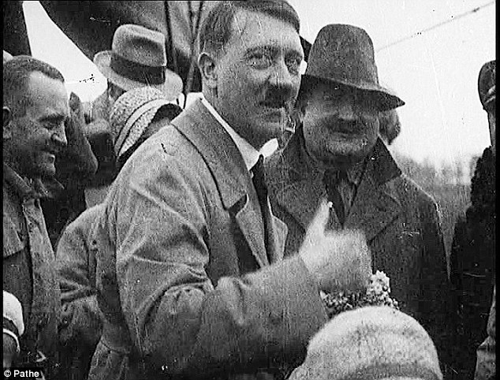
ANSWERS

Slide 13
1. How are marks awarded for this question?
Explain the historical context of Source 1. Include the relevant events, people and ideas depicted or represented in the source.
(4 marks)
Description | Marks
Identifies the focus of the source | 1
Outlines the causes or event that led to the focus of the source | 1
Provides specific details of the focus of the source, events/people/ideas/dates/places | 2
Total | 4
Note: This question is concerned with the historical context in which the source is located. Answers should: focus on what is in the source provide the big ‘picture’ for that source.

Slide 14
2. How are marks awarded for this question?
Compare and contrast the purpose of Sources 1 and 2. (5 marks)
Description | Marks
Identifies the purpose of Source 1 | 1
Identifies the purpose of Source 2 | 1
Identifies elements of comparison and contrast between the two sources | 1–3
Total | 5
Note: This question focuses on the reasons for the construction of the sources, and what they aim to achieve. Answers should: identify the issue/event/subject of each source identify the message of the sources identify the likely purpose for which the source was constructed (or, in the case of the photograph, how the source might have been used, which might produce variations in student interpretation) use evidence from the source to support the response explain how they compare (are similar) and contrast (are different) in terms of their purpose. A strong answer will integrate comparisons and contrasts within the discussion of purpose.

Slide 15
3. How are marks awarded for this question?
Explain the message of Source 3. (3 marks)
Description | Marks
Explains the message of the source | 3
Outlines the message of the source | 2
Identifies an aspect of the message of the source | 1
Total | 3
Note: Look for the message conveyed by the source. Answers should: consider all the elements of the source (title/author/date/location) identify the issue/event/subject identify the representation or opinion being expressed provide evidence from the source to support the response.

Slide 16
4. How are marks awarded for this question?
Identify how, and discuss why, Sources 3 and 4 are contestable. (6 marks)
Description | Marks
Identifies the element/s of contestability for Sources 3 and 4 | 1–2
Discusses the reasons for the contestability of Source 3 | 1–2
Discusses the reasons for the contestability of Source 4 | 1–2
Total | 6
Note: The concept of contestability requires a discussion of conflicting historical interpretations represented in source material, specifically why they are different and open to debate. Answers should: demonstrate an understanding of what can make a source contestable, whether it provides a certain interpretation of events for which other interpretations exist; or whether the source/s can be disputed as historical evidence identify in each source the argument/s, biases, motives or perspectives that can be disputed. Stronger candidates may discuss the nature of the contestability, perhaps by referring to alternative arguments or viewpoints on the interpretations presented by the sources, or by making comparisons between the two sources.

Slide 17
5. How are marks awarded for this question?
Using your knowledge of the whole period of study, evaluate the importance of the themes, ideas and/or events represented in the four sources. (7 marks)
Description | Marks
Identification of the themes/ideas/events | 1
Placement of the themes/ideas/events with the themes/ideas/events of the broader historical context of the time. Students should be able to demonstrate a breadth and depth of knowledge of the time period. | 1–2
Evaluation of the themes/ideas/events in relation to those of the broader historical context | 1–2
Compare and/or contrast what is in the sources with the other themes/ideas/events of the time period | 1–2
Total | 7
Note: This question does not require reiteration of the messages in the sources. Evaluate the importance of the theme/idea/event in relation to how they are represented in the sources; relates to the other themes/ideas/events of the whole period. Answers should: identify the themes/ideas/events in the sources evaluate the importance of what is shown in the sources by using evidence from the sources and the whole historical period refer to the long-term and/or short-term effects of the theme/idea/event refer to elements of continuity and/or change evident in the theme/idea/event demonstrate a depth and breadth of knowledge for the whole time period.

Slide 18
6. What is Anschluss?
The annexation of Austria into Nazi Germany on 12 March 1938.

Slide 19
7. What was the Soviet-Germany Non-Aggression pact?
Non-aggression pact between Germany and the Soviet Union signed 23 August 1939.

Slide 20
8. What was the Munich Pact?
(September 30, 1938), settlement reached by Germany, Great Britain, France, and Italy that permitted German annexation of the Sudetenland, in western Czechoslovakia.

Slide 21
9. What is appeasement?
To prevent further disagreement in arguments or war by giving to the opposing side an advantage that they have demanded.

Slide 22
10. What is Blitzkrieg?
Lightning war
A military tactic designed to create disorganisation among enemy forces through the use of mobile forces and locally concentrated firepower.

Slide 23
Results? /30

Slide 24

Source of the week

Slide 25
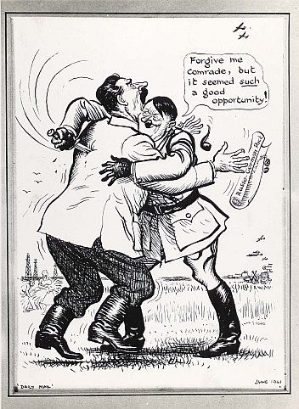
Write three questions you have about this source.

